Slide 1
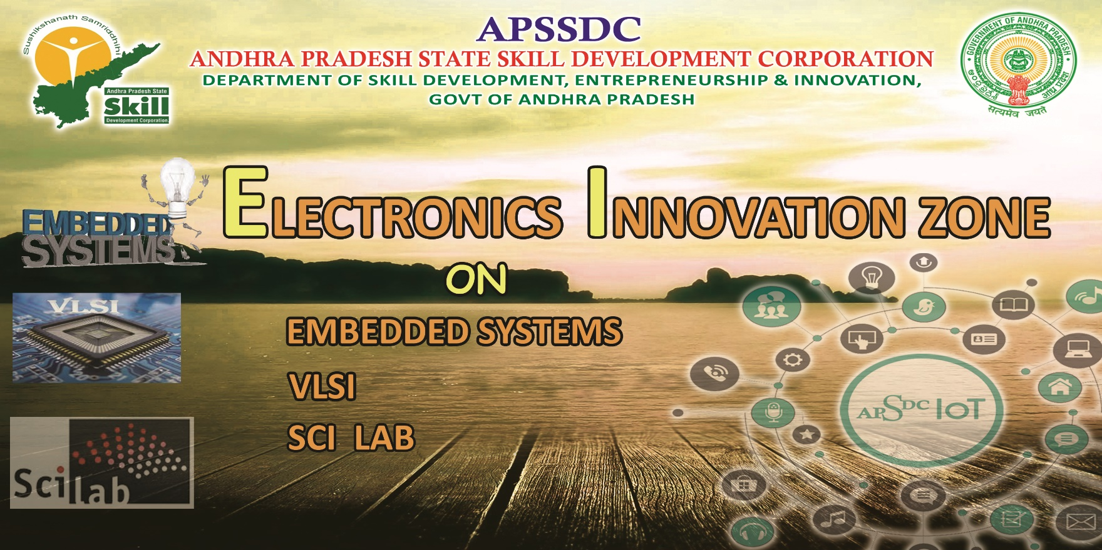

Slide 2
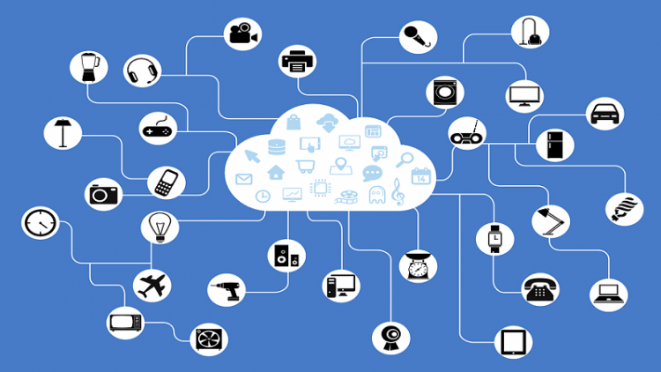
Internet of Things

Slide 3
Contents
Introduction/Overview
The Internet of Things
IoT Architecture
Applications of IoT
Future of IoT

Slide 4
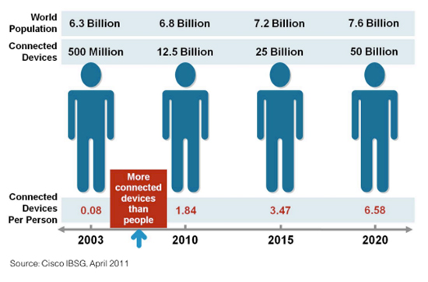
Internet Usage and Population Statistics

Slide 5
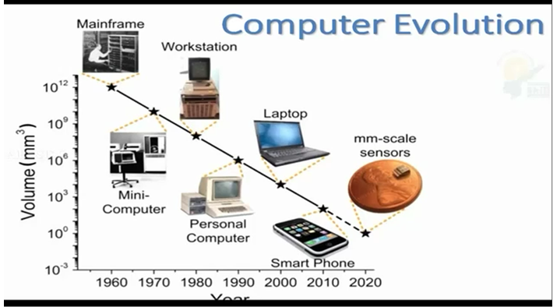

Slide 6
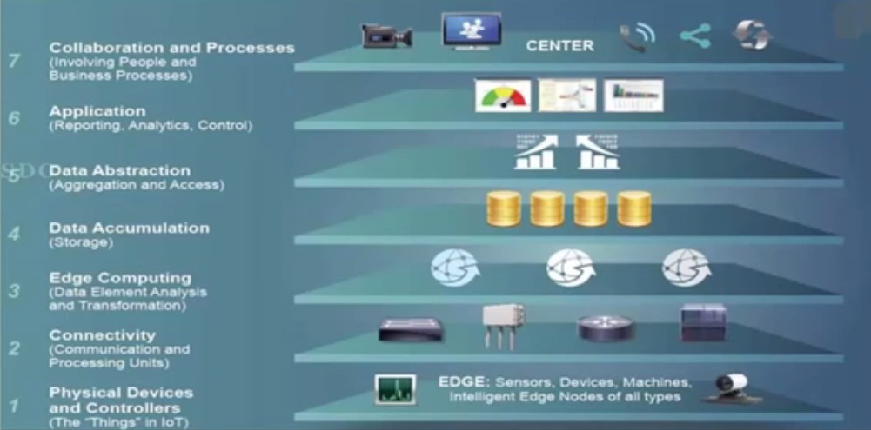
IoT Architecture

Slide 7
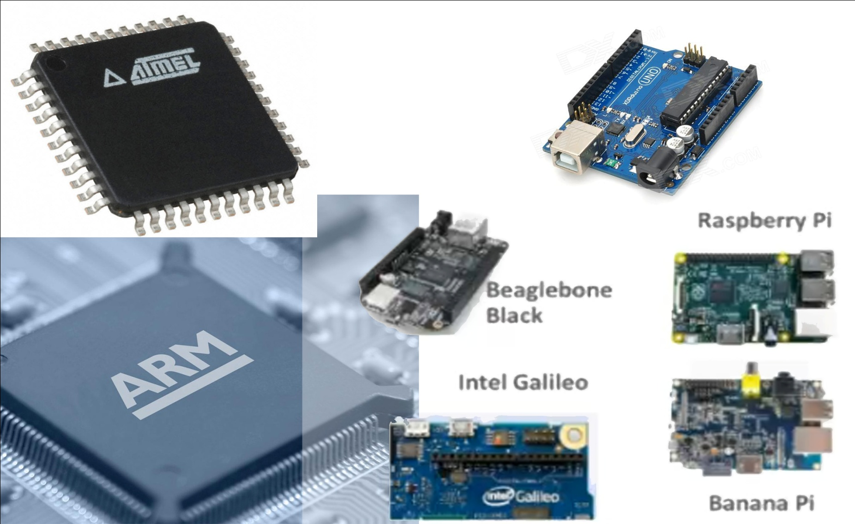
Physical Devices and Controllers

Slide 8
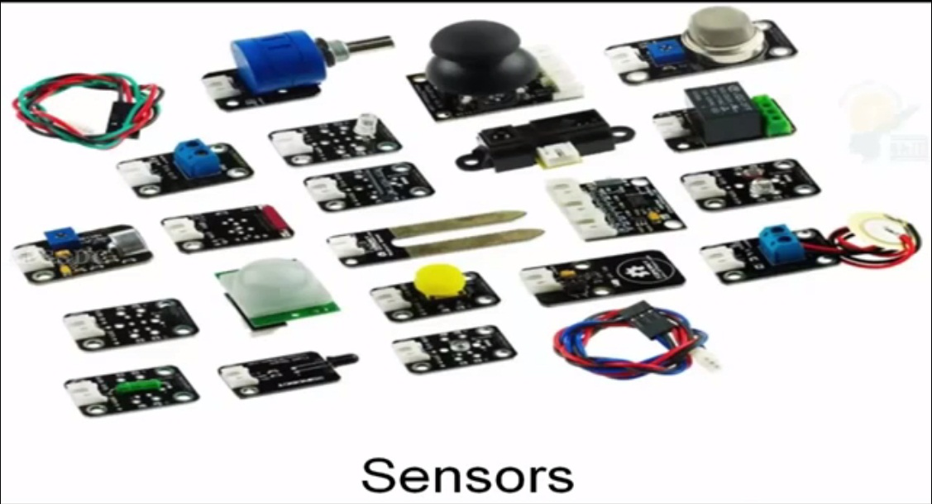
Sensors

Slide 9
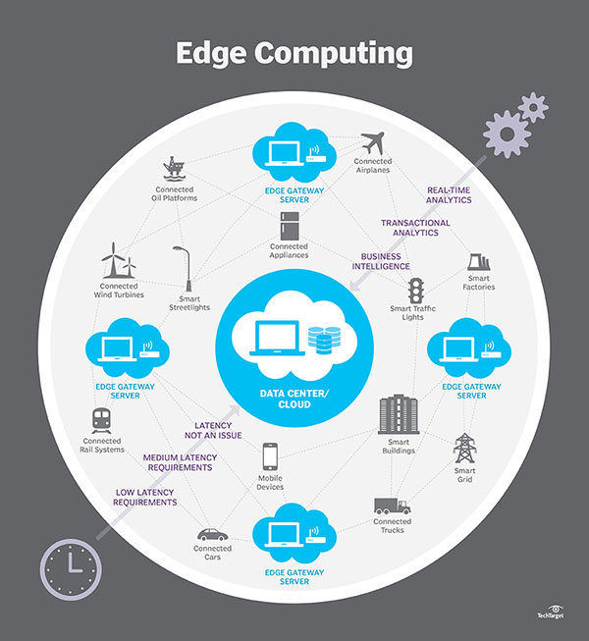
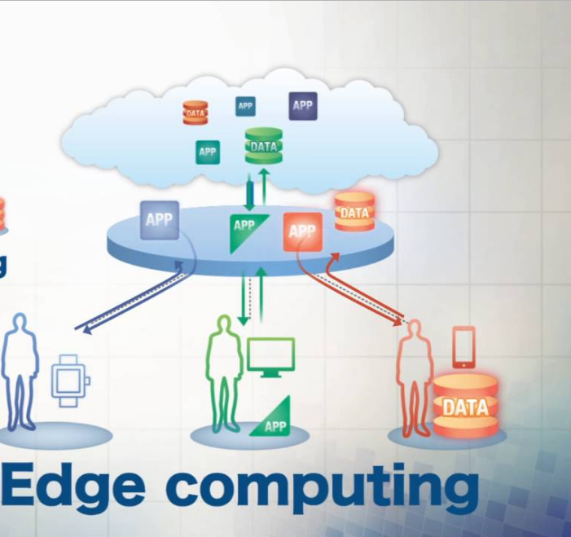
Edge Computing

Slide 10
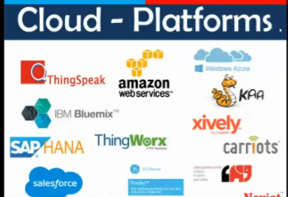
Cloud-Platfoms

Slide 11
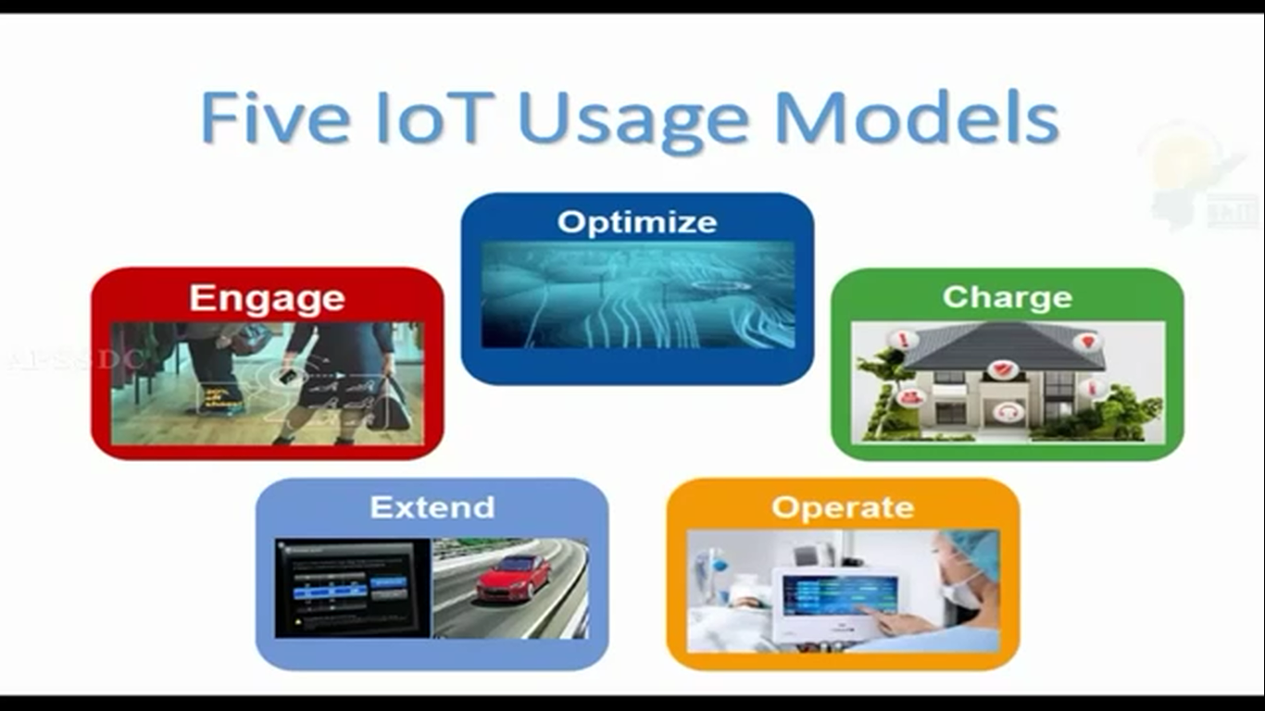

Slide 12
Applications of IoT
Management
Education
Retail
IoT Applications
Food
Logistics
Pharmaceuticals
Notes:
Logistics – Tagging items on a UPS truck (now they use barcodes to be scanned) but not real-time. Using the newer technology all is in realtime.

Slide 13
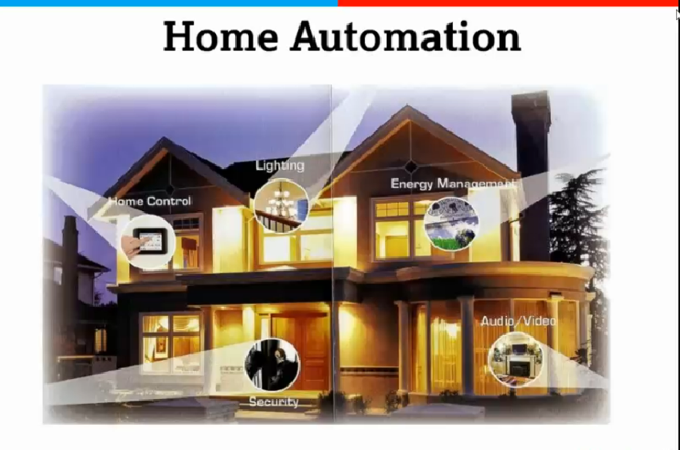
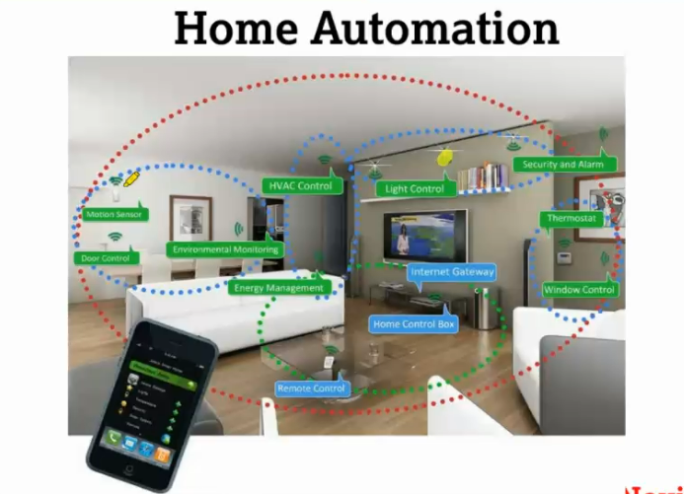
Home Automation

Slide 14
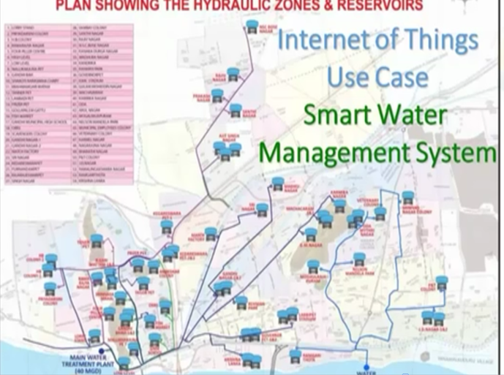
Smart Water Management System

Slide 15
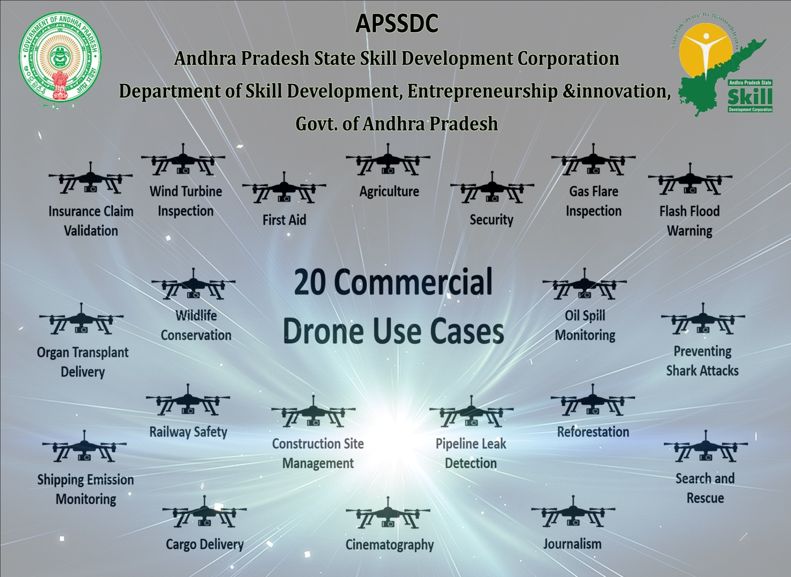

Slide 16


